Slide 1
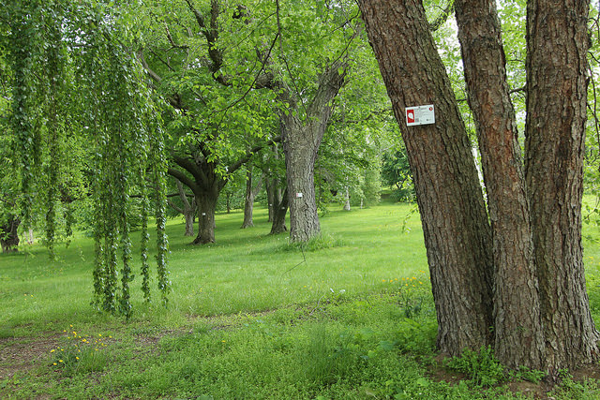
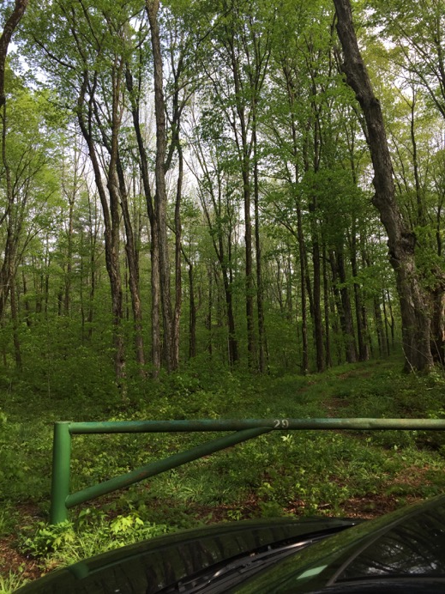
HARVARD FOREST
ARNOLD ARBORETUM

Slide 2
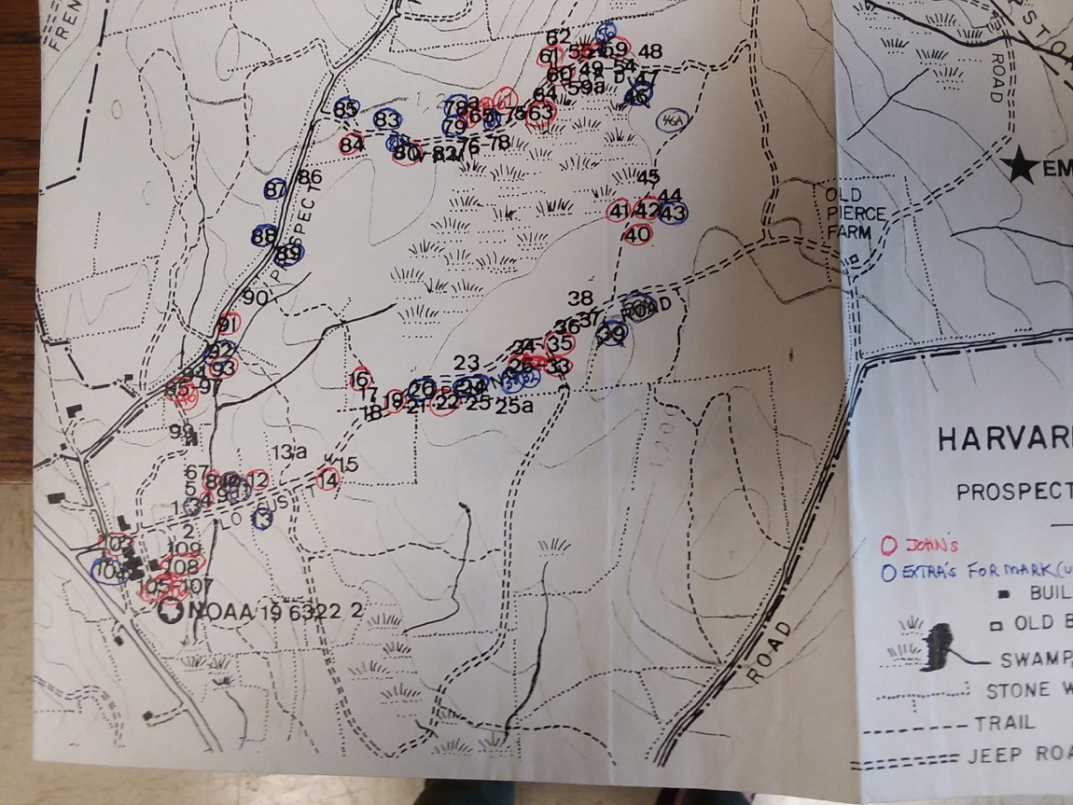

Slide 3
APPROACH 2:
Let’s try and see if there’s an `urban’ effect by combining sites into one model.
Again compare weather station data to hobo logger data in separate models
GDDlo ~ urban + (urban|species)
y_{i} ~ N(μ_{i}, σ)
y_{i} = ⍺_{I} + βx _{I} + σ
⍺_{I} ~ N(300, 100)
β_{i} ~ N(50, 20)

Slide 4
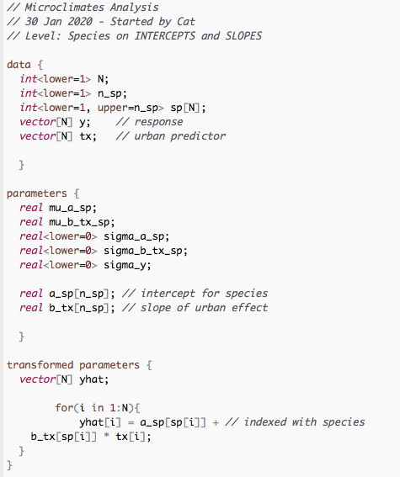
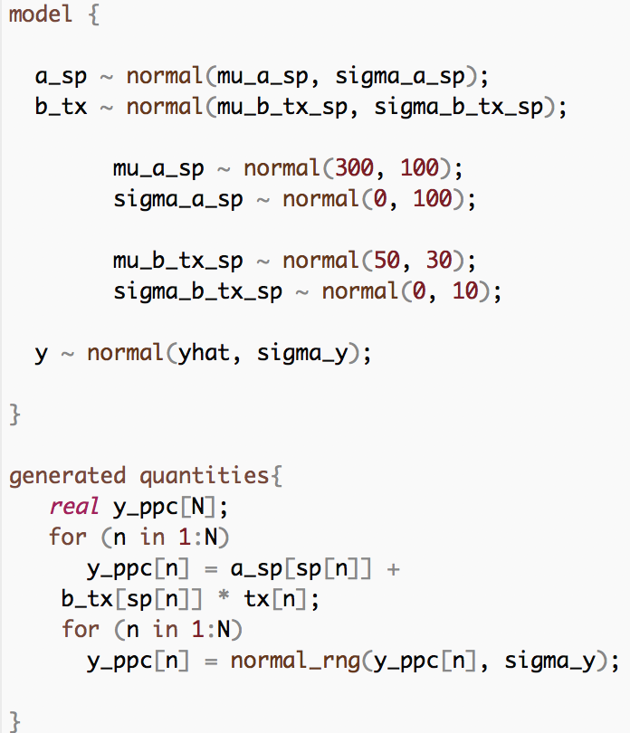
Model in Rstan

Slide 5
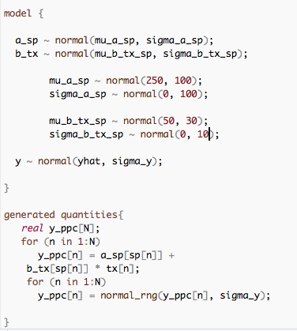
Model in Rstan for Hobo loggers:

Slide 6
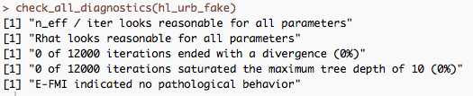
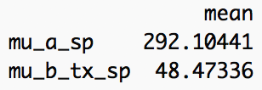
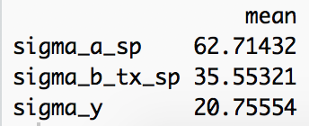
Model Check:
Fake Data:
GDD mean = 300
GDD sigma = 50
Urban effect mean = 50
Urban effect sigma = 20

Slide 7
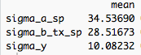
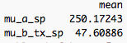
Model Check:
Fake Data:
GDD mean = 250
GDD sd = 30
Urban effect mean = 40
Urban effect sd = 10

Slide 8
WEATHER STATION
HOBO LOGGER

Slide 9
WEATHER STATION: 2019
WEATHER STATION: 2017-2019

Slide 10
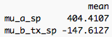
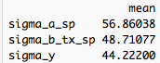
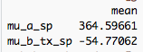
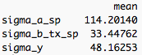
Model with Real Data
Weather Station data:
Hobo Logger data:

Slide 11
Raw Data
Weather Station
Hobo Logger

